Slide 1
Job Posting Clustering Project
Gary Guo

Slide 2
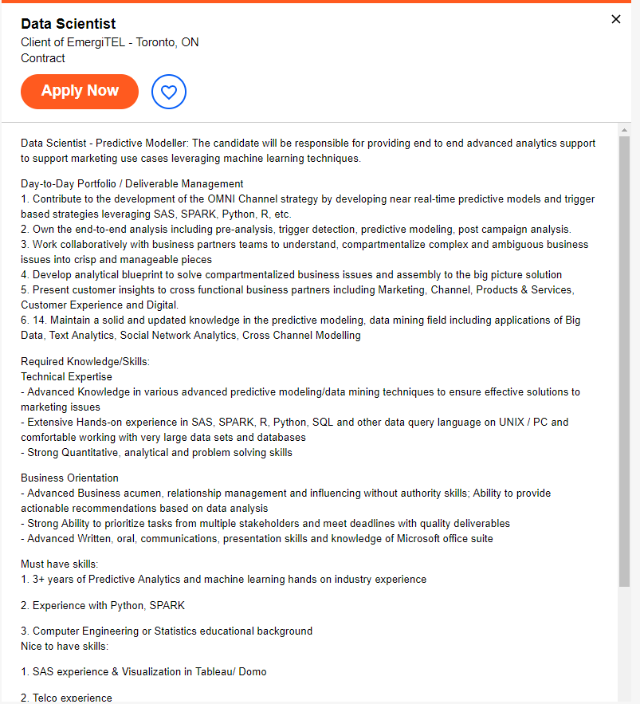

Slide 3
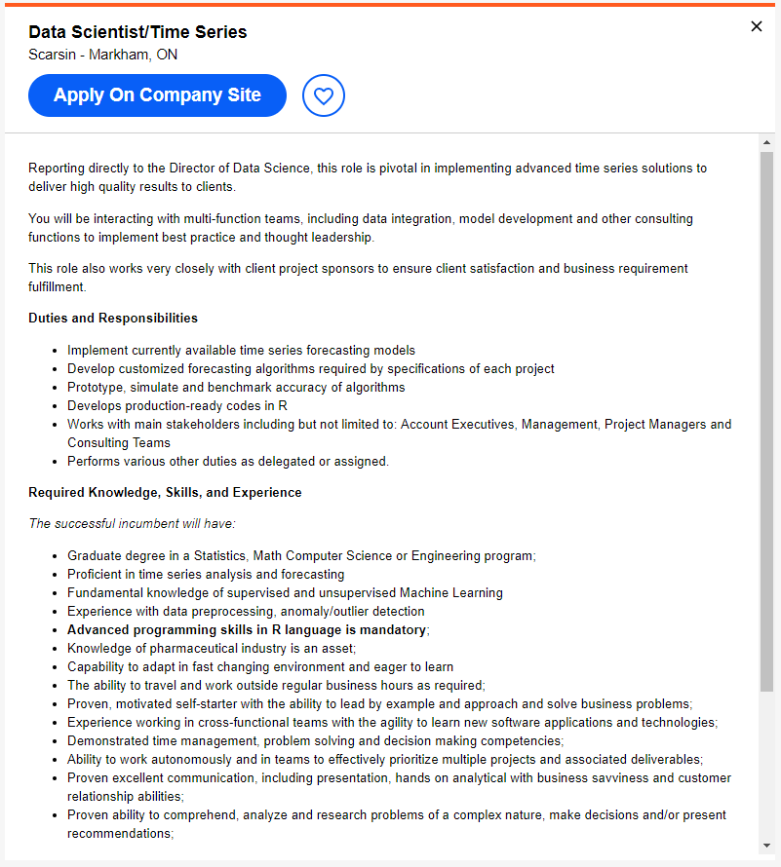

Slide 4
Goal
To use key words and phrases to cluster job postings
To identify the unique skills and expectations for each job cluster
To classify new job postings based on created clusters

Slide 5




Components
Indeed Web-scraper
Data Preprocessing and Modeling
Visualization

Slide 6
Exploration
TF-IDF | Word2Vec | LDA/Mallet
K-means | Hierarchical | Mean-shift | AP
t-SNE | MDS | PCA

Slide 7
Results
Word2Vec | LDA Mallet
K-means
t-SNE

Slide 8
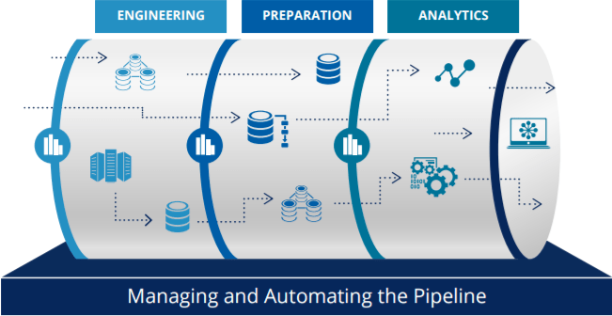
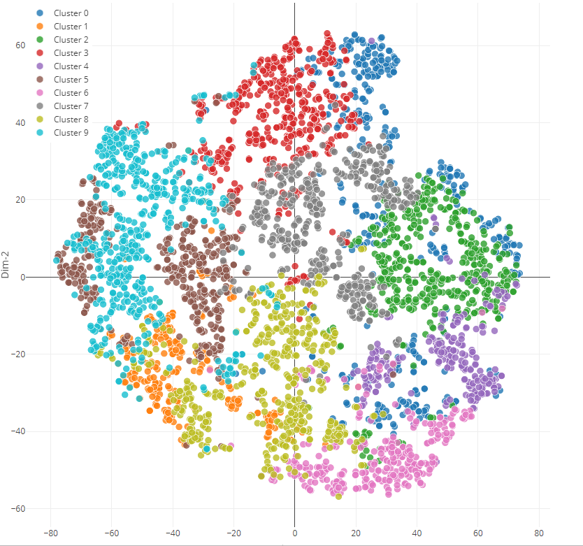
App Functionality
Test full scraper pipeline
Visually compare clusters
Test classification

Slide 9
Future
Phrase classification
Soft clustering
Higher granularity

Slide 10
Workflow

Slide 11
Sprint (I)
May 20th to May 27th
TF-IDF
K-means
Hierarchical
Mean-shift
Affinity Propagation
DBScan

Slide 12
Sprint (II)
May 28th to June 6th
Word2Vec
LDA/Mallet
t-SNE vs. PCA vs. MDS

Slide 13
Sprint (III)
June 6th to June 12th
Develop pipeline
Create visuals and finalize conclusion
Organize methodology
Plan presentation

